Slide 1
EE 551
Handwritten digits recognition- Framework Comparison
By
-Jainam Shah

Slide 2
Preface
The MNIST dataset is highly over-studied.
For someone to enter into the field of Machine Learning, this is the first step.
So, I decided to compare the different frameworks

Slide 3
Dataset
The MNIST database (Modified National Institute of Standards and Technology database) is a large database of handwritten digits that is commonly used for training various image processing systems.
The dataset has almost 60000 example images of handwritten numbers from 0 to 9.
Each example is a 28x28 pixel image flattened in an array with 784 values representing each pixel’s intensity.

Slide 4
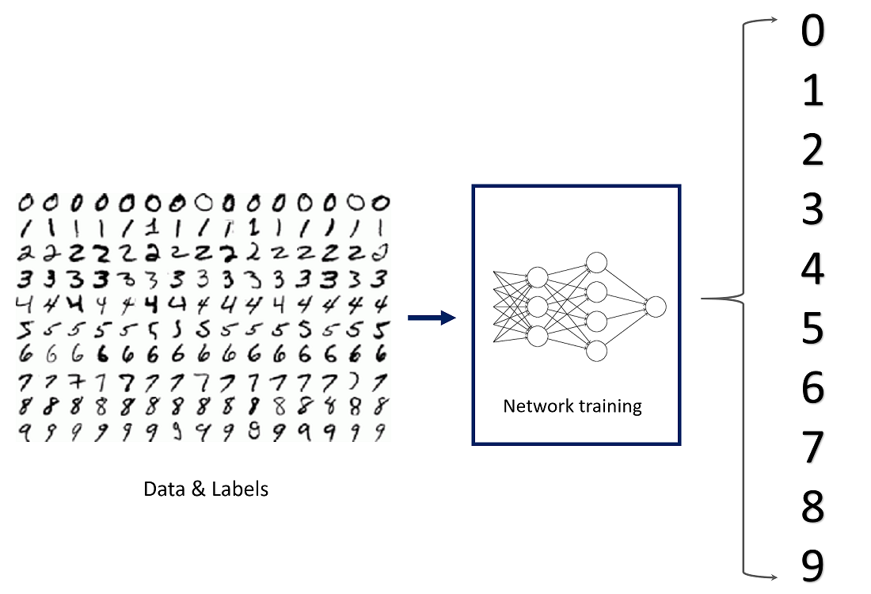

Slide 5
Convolutional Neural Network (CNN)
Convolutional Networks work by moving small filters across the input image. This means the filters are re-used for recognizing patterns throughout the entire input image.
This makes the Convolutional Networks much more powerful than Fully-Connected networks with the same number of variables.
This in turn makes the Convolutional Networks faster to train.

Slide 6
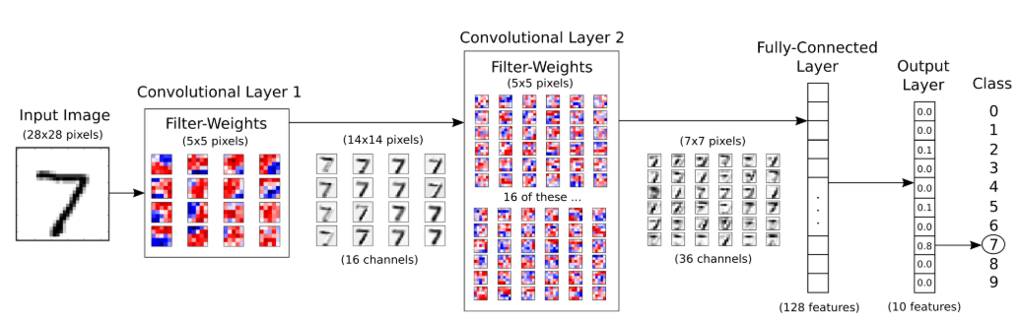
Implementation of Convolutional Neural Network (CNN)
The following chart shows roughly how the data flows in the Convolutional Neural Network that is implemented below.

Slide 7
Convolutional Layer
The following chart shows the basic idea of processing an image in the first convolutional layer. The input image depicts the number 7 and four copies of the image are shown here, so we can see more clearly how the filter is being moved to different positions of the image.
For each position of the filter, the dot-product is being calculated between the filter and the image pixels under the filter, which results in a single pixel in the output image. So moving the filter across the entire input image results in a new image being generated.

Slide 8
Convolutional Layer
The red filter-weights means that the filter has a positive reaction to black pixels in the input image, while blue pixels means the filter has a negative reaction to black pixels.
In this case it appears that the filter recognizes the horizontal line of the 7-digit, as can be seen from its stronger reaction to that line in the output image.

Slide 9
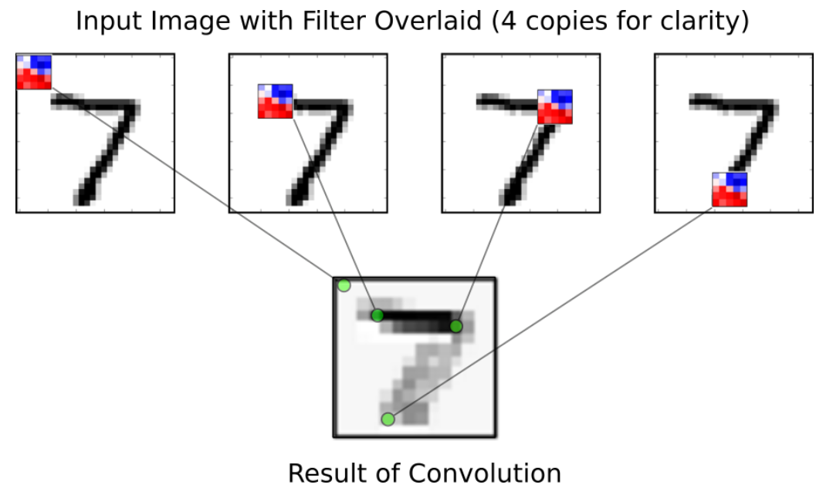
Convolutional Layer (contd…)

Slide 10
Frameworks
SKLearn
Tensorflow
Pytorch
Apache Mxnet/ Amazon Gluon

Slide 11
SKLearn
The following algorithms are implemented:
Algorithm | Accuracy
Stochastic Gradient Descent | 88.98%
Random Forest | 93.86%
SVM | 91.02%

Slide 12
TensorFlow
The following algorithms are implemented:
Algorithm | Accuracy
Keras- deep learning | 97.87%
Tensorflow- Convolution Neural Networks | 91%

Slide 13
PyTorch
The following algorithms are implemented:
Algorithm | Accuracy
PyTorch- Convolution Neural Networks | 97.8%

Slide 14
Apache MXnet/ Amazon Gluon
The following algorithms are implemented:
Algorithm | Accuracy
Multilayer Perceptron | 97.01%
Convolution Neural Networks | 98.95%

Slide 15
Comparisons of different methods
Method | Accuracy
SKLearn
Tensorflow
PyTorch
Apache MXnet / Amazon Gluon

Slide 16

Conclusion
Amazon Gluon/ Apache Mxnet has the highest efficiency of 98.95%

Slide 17
Citations
Tensorflow Documentation
Pytorch Documentation
Apache Mxnet Documentation

Slide 18
Thank You !!
Any Questions???
18

